Slide 1

Dept. of Psychology
Lab Preview
September 9, 2026

Slide 2

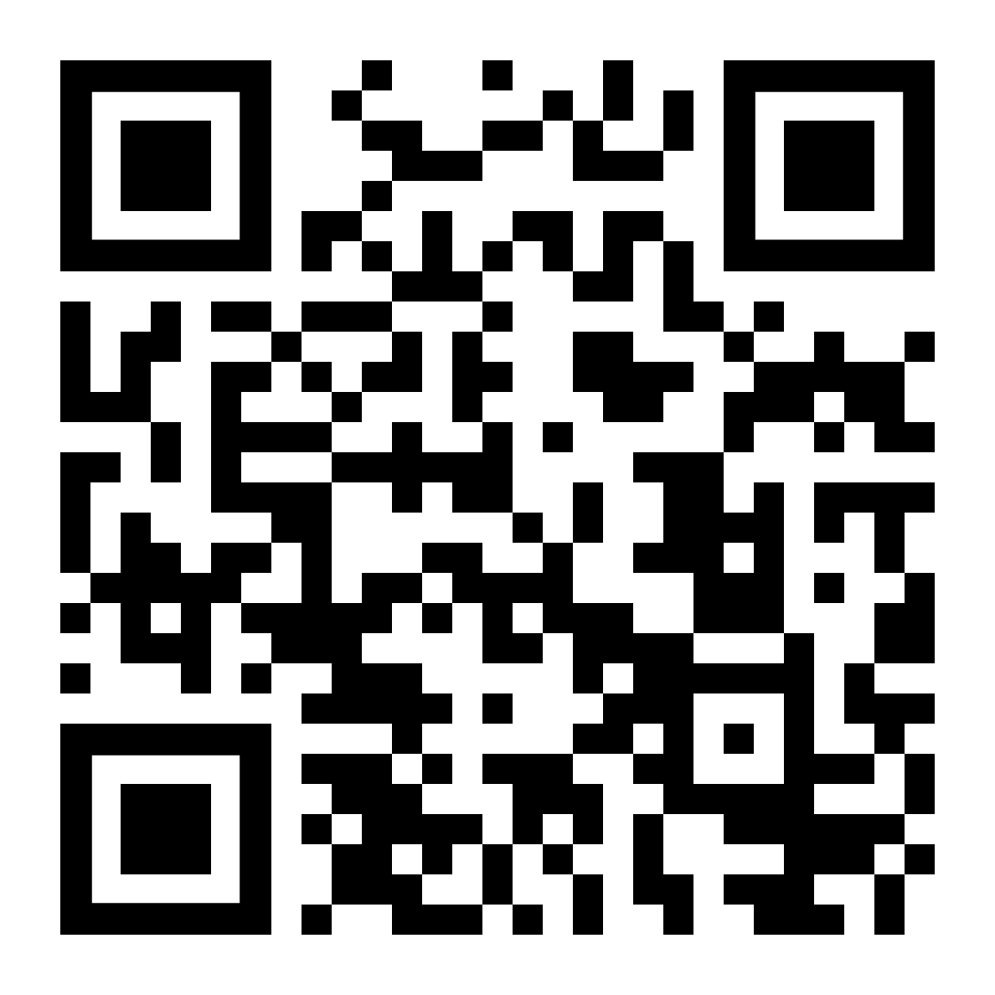
Social Cognitive and Affective Neuroscience Lab
Prof. Kevin Ochsner
We study emotion, self-control, and social behaviour
Multiple levels of analysis from behavioural to neuroimaging
Social regulation of emotion: how a person tries to alter the emotional responses of another person. e.g., when your friend is upset and you try to make them feel better
Looking for RAs for 2 projects; participant-facing, behavioural, and interested in studying social interactions
Apply here (https://forms.gle/gt5eGUsLCZfjL4Qb7) or through the QR code by Mon. Sept 14th.
Visit https://www.ochsnerscanlab.org/

Slide 3

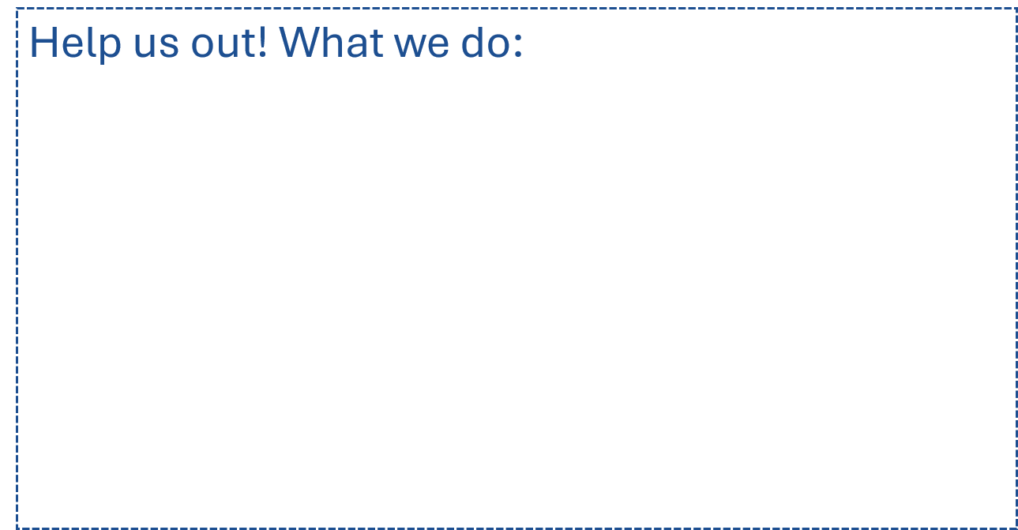
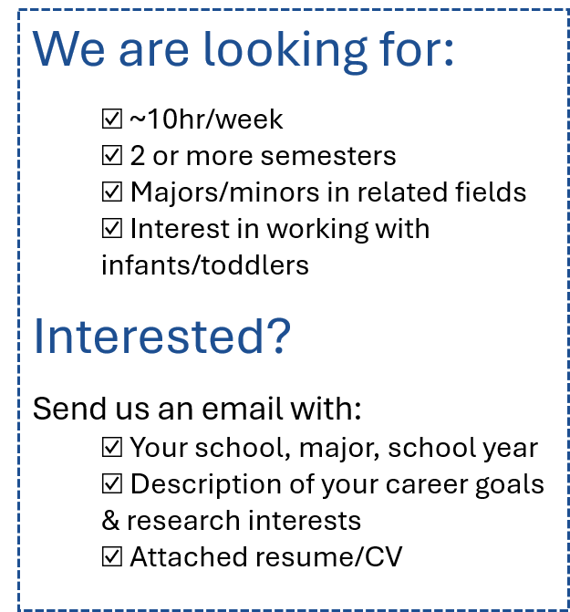

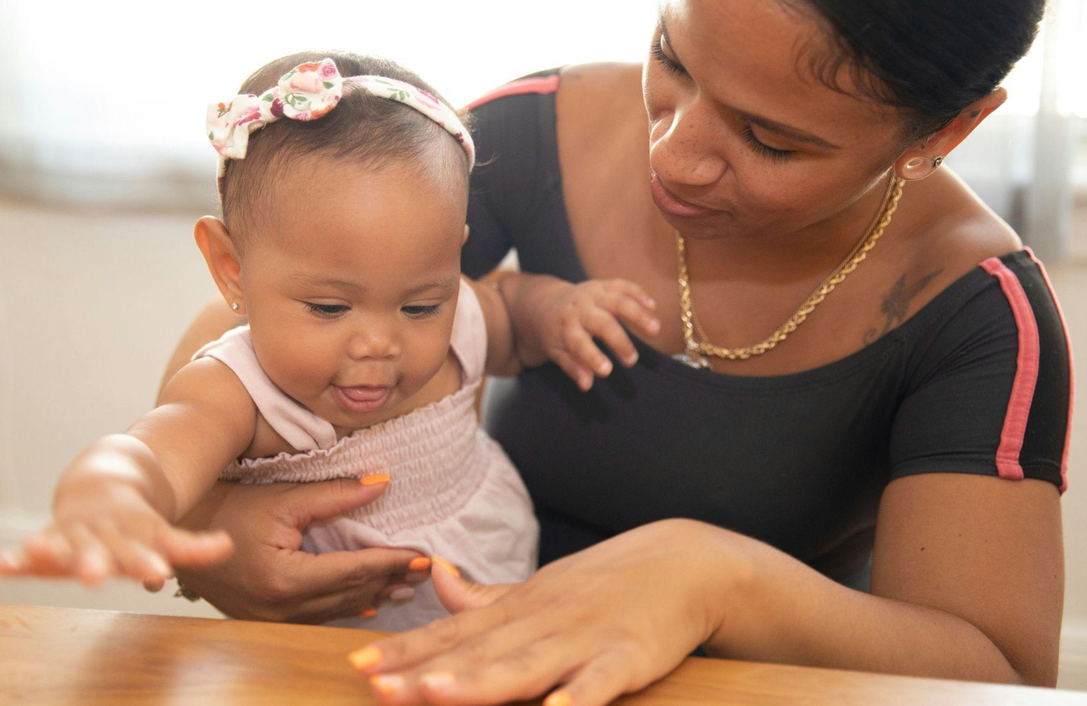
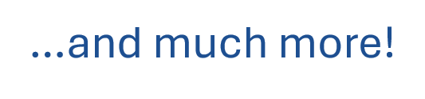
PI: Dr. Dima Amso
Contact Us!
dcnlabcolumbia@gmail.com
Looking at how Parent-Child interactions relates to development
Eye-tracking studies to look at attention, memory, and social development
Photo credit: @nappystudio

Slide 4
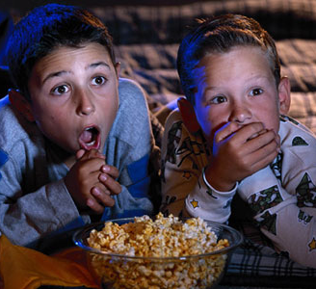
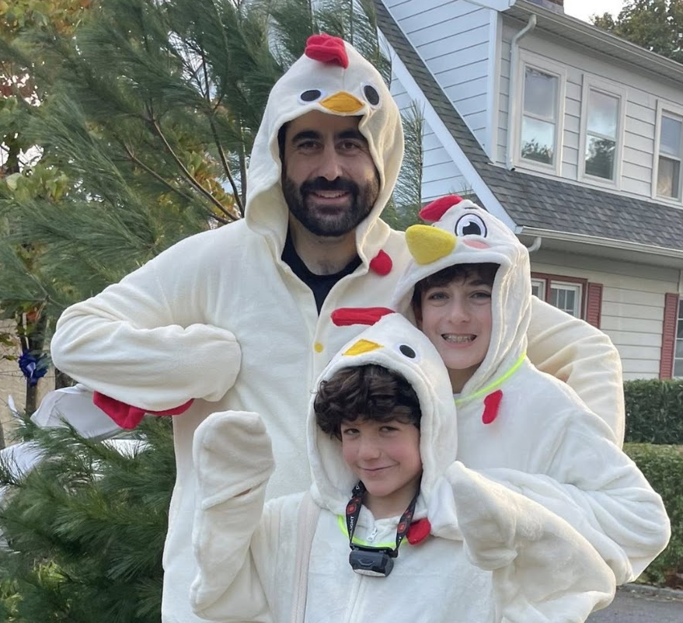



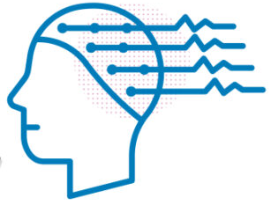
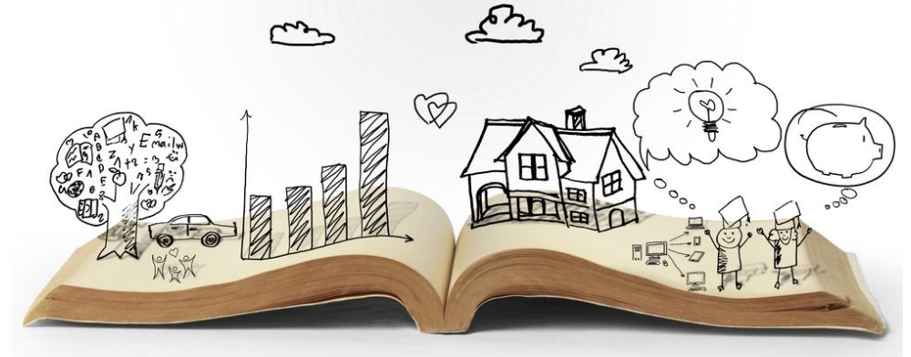
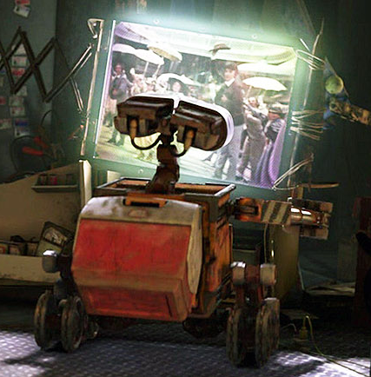
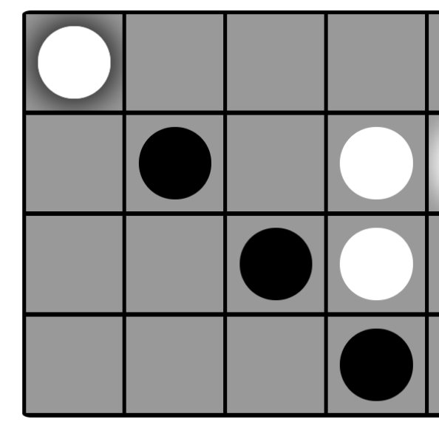
PI: Chris
Baldassano
Movies
fMRI
Music
iEEG
Stories & Poetry
Computational
models
Games

Slide 5

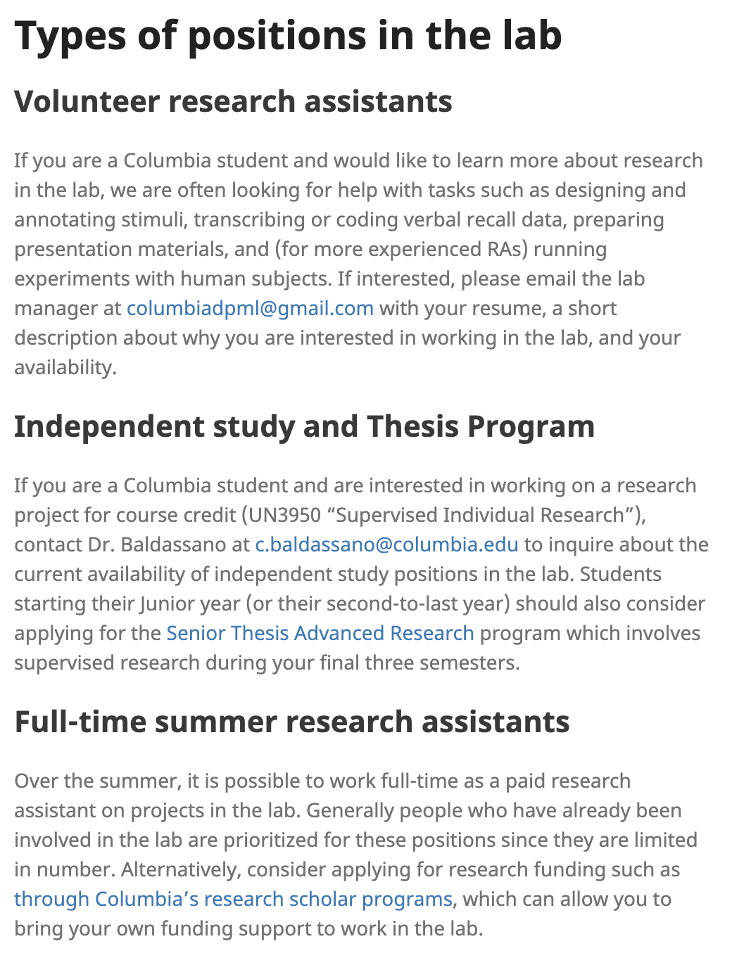
https://www.dpmlab.org/
Prioritize RAs that are looking for 2+ semesters of research, to help with:
Data collection
Data curation
Data analysis
For thesis students: designing and running your own study

Slide 6
CyberPsych Lab
01
A teaching lab where student researchers move projects from idea to publication.
12
70+
PI: Dr. Usha Barahmand (ub2142@columbia.edu)
Lab Manager: Albaraa Gebril (amg2451@columbia.edu)
ACTIVE GROUPS
RESEARCH ASSISTANTS (Undergraduate & Graduate)
WHY ARE WE CALLED THE CyberPsych LAB?
We Collect data through cross-sectional online surveys + lab operates fully online.
~5 HOURS / WEEK
WHAT WE STUDY
MENTORSHIP
Questions spanning criminal behavior, clinical psychology, trauma, decision-making, social behavior, ADHD, OCD, and more.
Dr. Barahmand also serves as the main PI for lab members conducting senior theses through the Senior Thesis Advanced Research program.

Slide 7
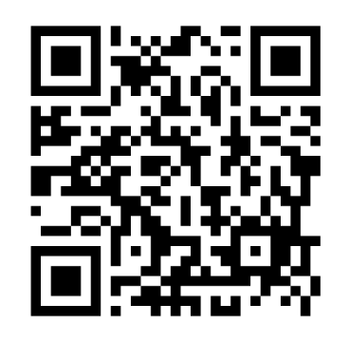
Learn the full research process by doing it
02
Research assistants contribute at every stage, with mentorship along the way.
LITERATURE REVIEWS → RESEARCH QUESTION → DATA COLLECTION & ANALYSIS → MANUSCRIPT WRITING → PUBLICATION → CONFERENCE PRESENTATIONS
PRESENT YOUR WORK
RECRUITMENT UPDATE
Oral and poster presentations at national APA and EPA conferences.
We are not currently accepting new RAs now. Scan the QR code and complete the application to be added to the waitlist for likely recruitment in Spring 2027.
PI Usha Barahmand • ub2142@columbia.edu | Lab Manager Albaraa Gebril • amg2451@columbia.edu

Slide 8


Who: Geraldine Downey & Nora Isacoff
Research question: How do narrative identity and self-communication develop over the course of a community violence intervention?
Method: Qualitative coding of longitudinal interview data
Commitment: 10–12 hours/week · Minimum 1 year
To apply: Email ni2237@columbia.edu with your resume and a short paragraph about your interest in the project and ability to make the 10–12 hour/week, one-year commitment.

Slide 9
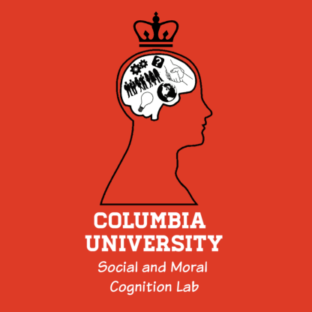
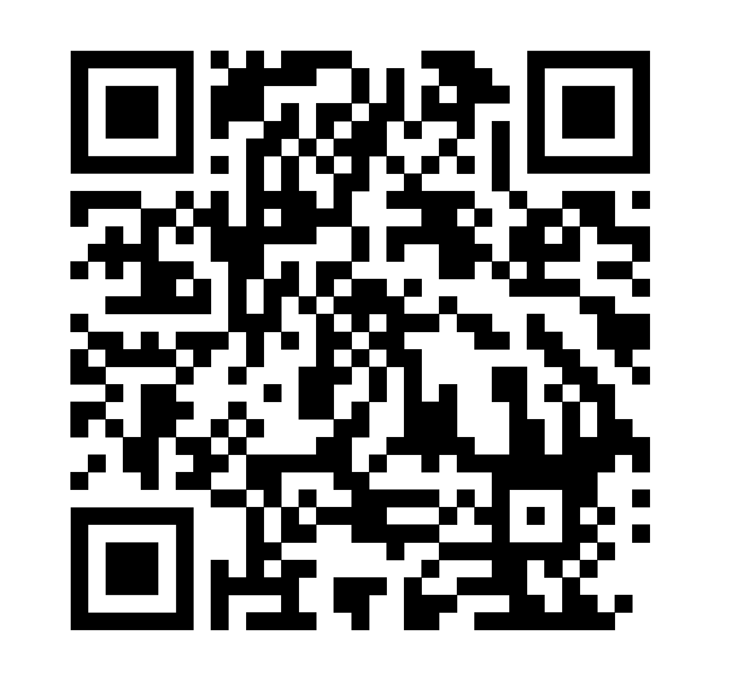
Social and Moral Cognition Lab
PI: Dr. Larisa Heiphetz Solomon
Contact Us: columbiasamclab@gmail.com
What do we study?
We study how children and adults understand their social world. We are currently investigating how people in different age groups...
make moral decisions
reason about and interact with people who are different from them
reason about supernatural entities (e.g., God)
perceive the criminal justice system
and more!
Interested in working with us?
Commitment of at least 10 hours per week, including some weekend availability
Experience working with children preferred, but not required

Slide 10
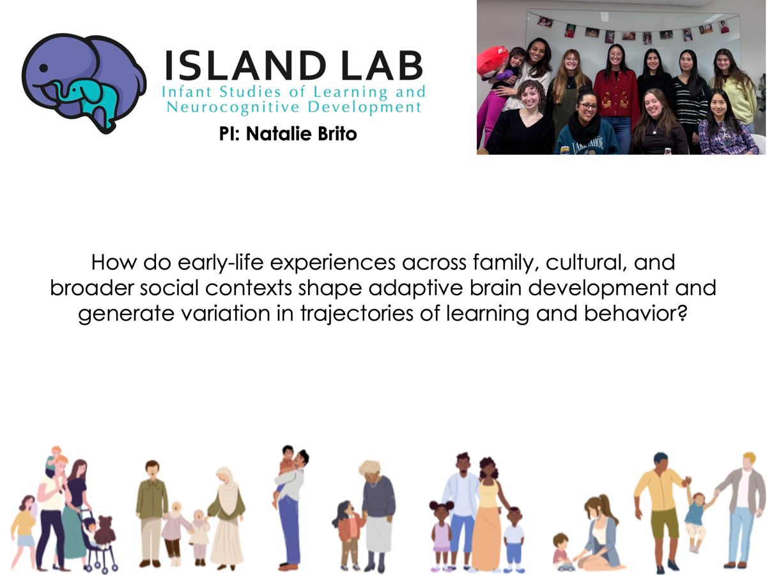
Email: mz3120@columbia.edu

Slide 11
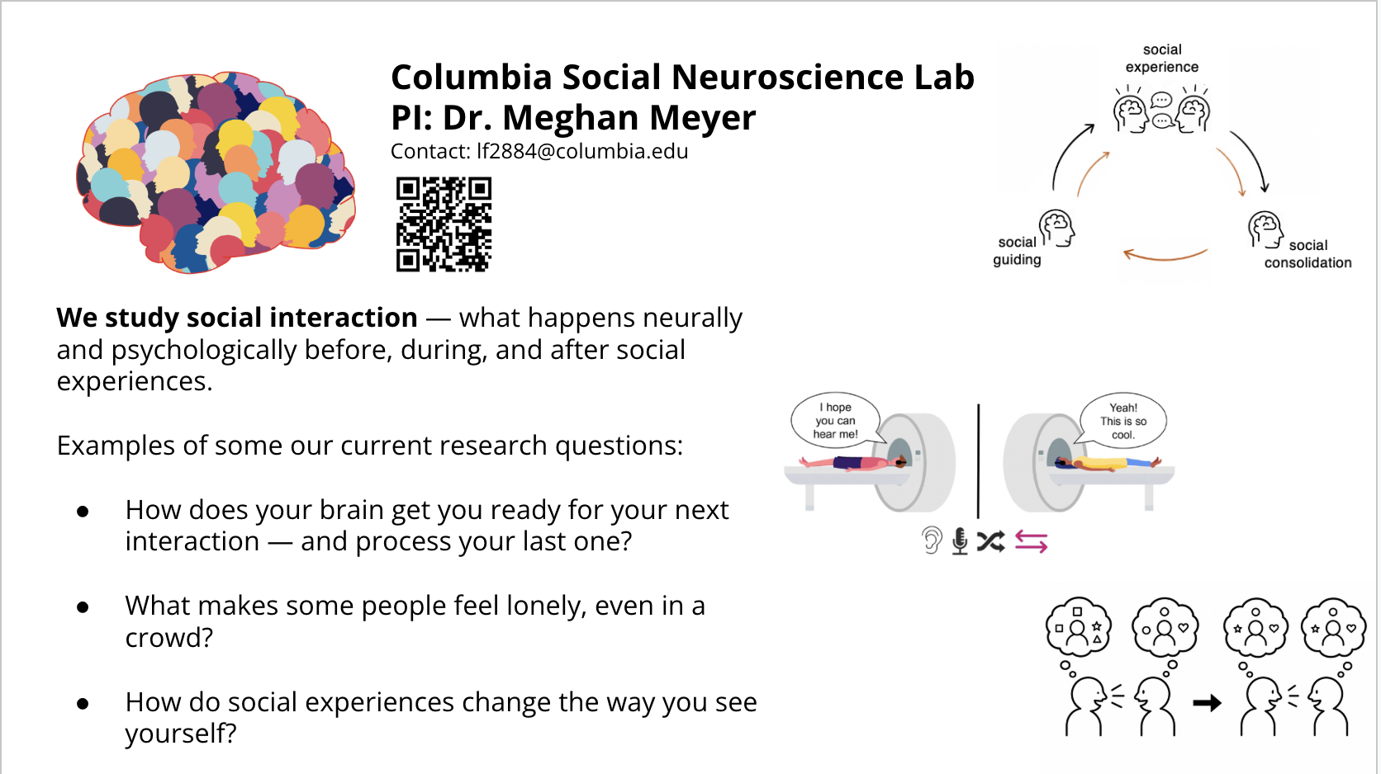

Slide 12
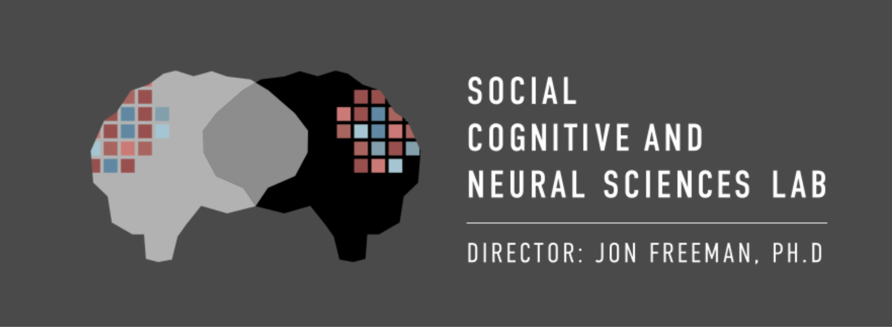
freemanlab.org

